Slide 1
Skin lesion classification using artificial intelligence
Farzana Kousar
FA19-REE-018
ECI743 Computer Vision
COMSATS University Islamabad, Wah Campus
Department of Electrical and Computer Engineering

Slide 2






I. Introduction
II. Literature Review
CONTENTS
III. Methodology
IV. Application
V. References

Slide 3
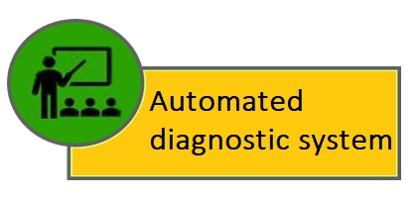
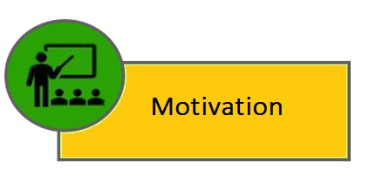
I. Introduction

Slide 4
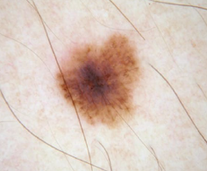
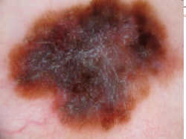
Motivation
Skin lesion is becoming global disease burden as it causes disability worldwide. The most perverted form of skin lesion is skin cancer.
Skin cancer is the topmost dangerous skin lesion and included in one of life-threatening skin lesions
Conventional clinical approaches: Biopsy & Dermoscopy(ABCDE rule).
These methods are Invasive, time consuming, prone to human error, needs intense practice, experience and expertise
Need of a reliable automated and non-invasive diagnostic system
Figure 1a. Benign skin lesion
Figure 1b. Malignant skin lesion

Slide 5
Automated Diagnostic System
The amalgam of computer vision and machine learning have proven to develop amazing automated diagnostic system.
These automated systems help early and accurate detection (non-invasive) of skin lesion with a level of competence comparable to domain experts who are using conventional methods of classifying skin diseases
In progression of machine learning based automation, deep learning methods are now leading the way and achieving significant performance and promising results.

Slide 6
Year | Methods | Classification Accuracy
1
2019 [1] | hybrid classifier: K-Nearest Neighborhood (KNN), Support Vector Machine (SVM), and Multilayer Perceptron (MLP) Neural Network | 96%
2
2019 [2] | Segmentation (clustering and thresholding) -multi-layered feed-forward artificial neural network (ANN) -AlexNet classifier | 94.45%
3
2019 [4] | Deep CNN, Inception.v.3 | 91%
2019 [3] | local binary patterns (LBP) clustering and Gradient Histogram Thresholding (GHT) for segmentation traditional machine learned classification | 90%
4
5
2019 [5] | FrCN segmentation[12][2019 CNN classifiers | 89.98 %

Slide 7



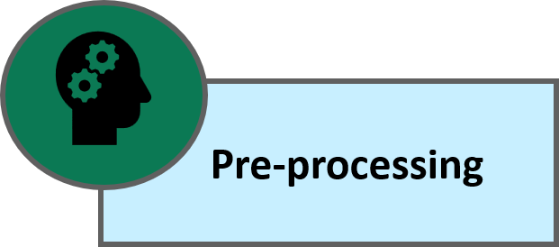

III. Methodology

Slide 8
Data Acquisition
Data will be acquired through different online sources like
https://www.nature.com/: The HAM10000 dataset, a large collection of multi-source dermatoscopic images of common pigmented skin lesion made publicly available by the Harvard database on June 2018.
https://www.isic-archive.com/: international skin imaging collabration
ImageNet. http://www.image-net.org
Kaggle.com

Slide 9
Suggested Approach
Pre-Processing
Segmentation
Classification
Feature Extraction
Diagnosis
Melignant
Benign

Slide 10
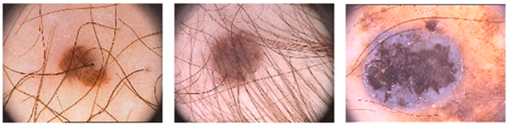
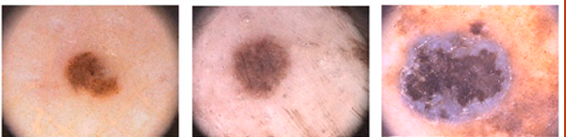
Pre-Processing: Noise Removal
It involves to remove different types of noises in raw signals i.e.
hairs, air bubble, skin lines, blood vessels.
Inherent noise in electronics equipment, motion artefact etc.
Figure 2a. Raw images
Figure 2b. Preprocessed images[1]

Slide 11
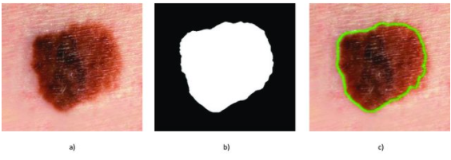
Pre-Processing: Segmentation
Extraction the attributes related to clinical images.
Segmentation of the lesions will be done deep network i.e. MASK RCNN to extract region of Interest(ROI).
Figure 3. Skin lesion segmentation. a) Dermoscopic image in input. b) Binary mask in output. c) The border of the mask overlaid on the image [6].

Slide 12
Feature Extraction
Quality of features extracted directly affects the classification accuracy
feature will be extracted using transfer learning.
Curse Of Dimensionality :To overcome the problems of curse of dimensionality, we will be using a pyramid model which will at the initial phase, select the relevant features, and in the next stage reduces the overall dimensions of our feature vector.

Slide 13
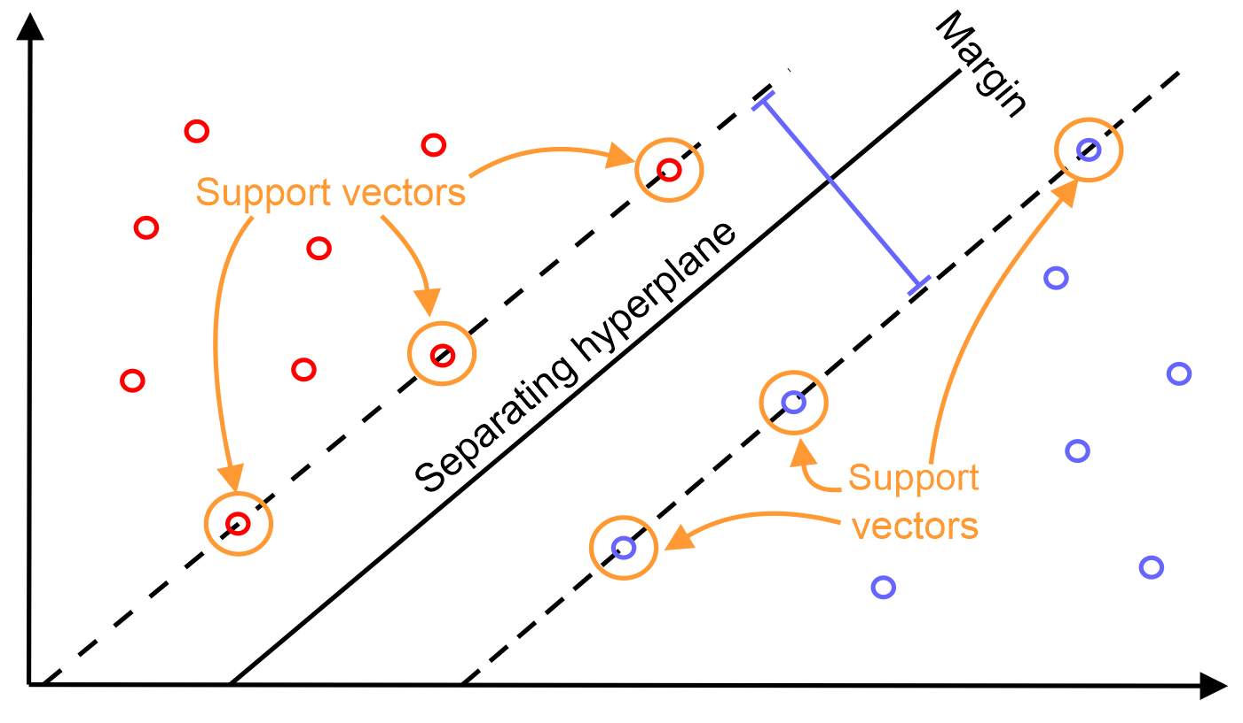
Classification
Support Vector Machine
SVM is broadly used for the classification of biomedical images/signals.
SVM works by creating a hyperplane in which training features are separated by a maximum difference from hyperplane

Slide 14
Application
Automated skin lesion diagnostic system with improved classification accuracy to reduce melanoma mortality.
When it is diagnosed and treated at earliest stage, The chances of survival increase more than 90 % .
It will be helpful to dermatologist to determine skin lesion in less time with the accuracy at a level of competence comparable to domain experts who are using conventional methods of classifying skin diseases.
These algorithms may be used to develop Android based application to help user to monitor and diagnose these type of skin lesion.

Slide 15
References
[1] G. S. Ghalejoogh, H. M. Kordy, and F. Ebrahimi, “A hierarchical structure based on Stacking approach for skin lesion classification,” Expert Syst. Appl., vol. 145, p. 113127, 2020, doi: 10.1016/j.eswa.2019.113127.
[2] N. Hameed, A. M. Shabut, M. K. Ghosh, and M. A. Hossain, “Multi-class multi-level classification algorithm for skin lesions classification using machine learning techniques,” Expert Syst. Appl., vol. 141, p. 112961, 2020, doi: 10.1016/j.eswa.2019.112961.
[3] D. A. Gavrilov, N. N. Shchelkunov, and A. V. Melerzanov, “Deep learning based skin lesions diagnosis,” Int. Arch. Photogramm. Remote Sens. Spat. Inf. Sci. - ISPRS Arch., vol. 42, no. 2/W12, pp. 81–85, 2019, doi: 10.5194/isprs-archives-XLII-2-W12-81-2019.
[4] P. M. M. Pereira et al., “Skin lesion classification enhancement using border-line features – The melanoma vs nevus problem,” Biomed. Signal Process. Control, vol. 57, p. 101765, 2020, doi: 10.1016/j.bspc.2019.101765.
[5] M. A. Al-masni, D. H. Kim, and T. S. Kim, “Multiple skin lesions diagnostics via integrated deep convolutional networks for segmentation and classification,” Comput. Methods Programs Biomed., vol. 190, p. 105351, 2020, doi: 10.1016/j.cmpb.2020.105351.
[6] Bakheet S. An SVM framework for malignant melanoma detection based on optimized HOG features. Computation. 2017 Mar;5(1):4.

Slide 16


